Slide 1
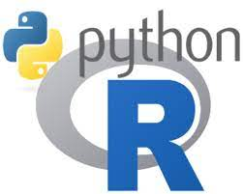
Data Analytics with Python and R
By Maz

Slide 2
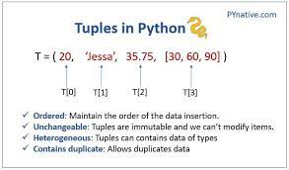
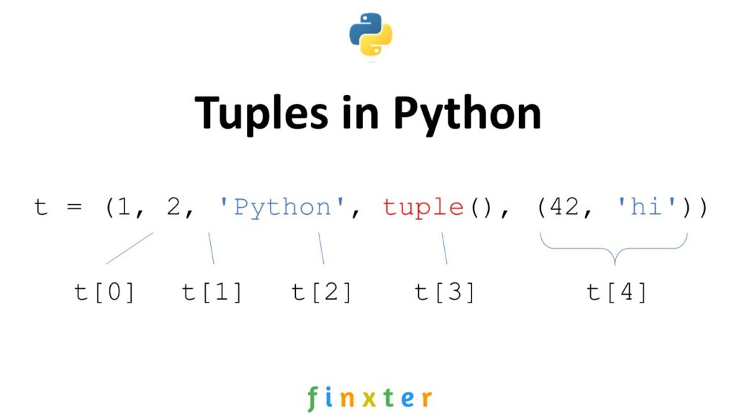
Tuples in Python
Multiple items can be stored in a single variable by using tuples.
One of the four built-in data types in Python for storing data collections is the tuple; the other three are list, set, and dictionary, each with a unique set of features and applications.
A tuple is an unchanging, ordered collection.

Slide 3
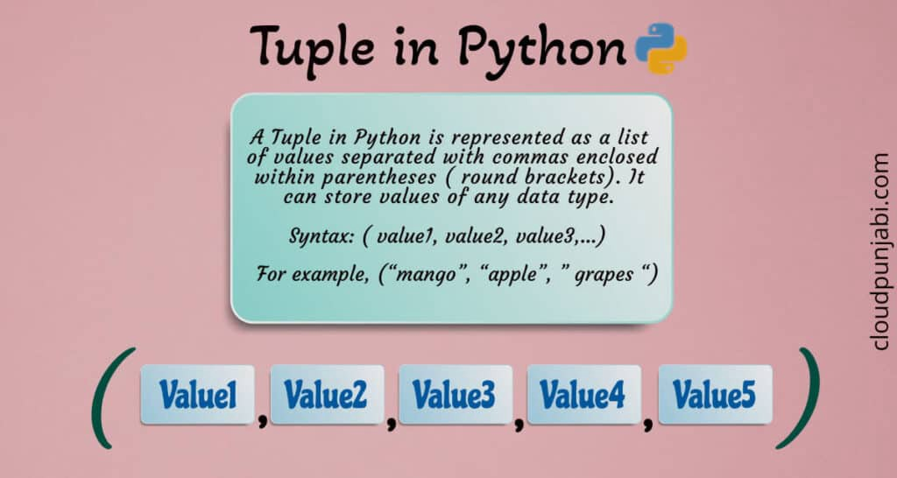
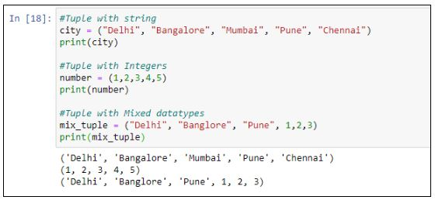
Tuples in Python(continued)
A Python tuple is an unchangeable list of objects in a particular order. In other words, once the sequence is constructed, neither new items nor existing objects in the sequence can be changed. A tuple is made up of many values that are separated by commas. Tuples are surrounded behind parenthesis "()," unlike a Python list.

Slide 4
Tuples properties
For tuples, the following characteristics are different:
Tuples are organised groups of objects of any type.
Object collections are arranged from left to right.
Access to items in tuples is made possible via offset.
Pulling a slice, indexing, and other operations that are needed to offset elements are supported by tuples.
Sequences that are immutable are referred to as tuples.
Tuples are not capable of supporting direct change operations.
On the other hand, if one element of the tuple is mutable (like a list), the tuple can alter that member.
Tuples are differentiable.
Tuples can contain other composite objects, such as lists, rows, or other tuples, which is what the term "heterogeneous" refers to.
Tuples allow for any quantity of attachments.
The length of a tuple is fixed.
A replica of the tuple with a different length must be made in a new memory location if the length of the original has to be changed.
Arrays of object references can be used to represent tuples.

Slide 5
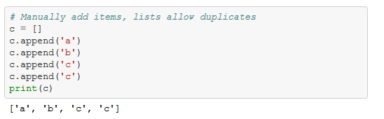
Tuples properties (continued)
Allow Duplicates
Since tuples are indexed, they can have items with the same value

Slide 6
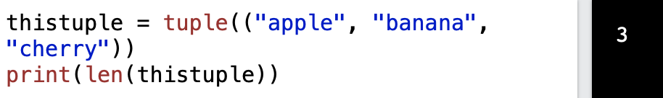
Tuple Length
Use the len() function to determine how many entries a tuple contains

Slide 7
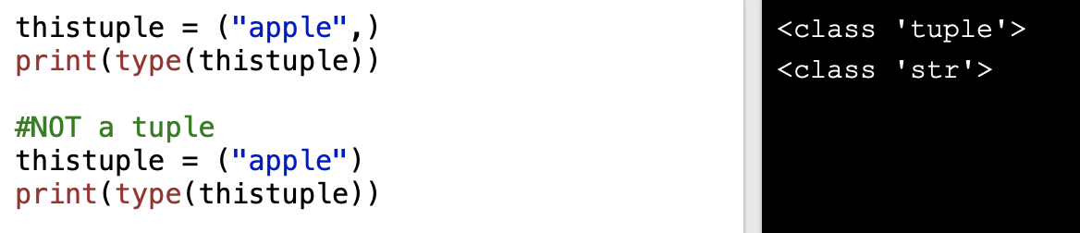
Make A Tuple From One Item
Python will not recognise a single item as a tuple unless you add a comma after the item to make it a tuple.

Slide 8
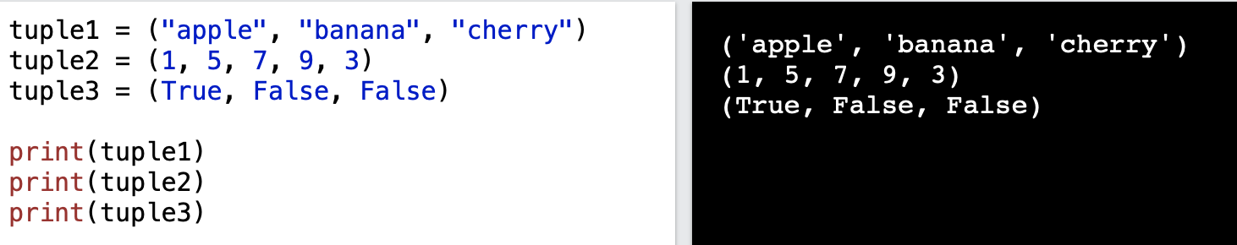
Data Types for Multiple Items
Any data type can be a triple item:
boolean, int, and string data types

Slide 9
Data Types for Multiple Items(continued)
Different data types can be included in a tuple:

Slide 10
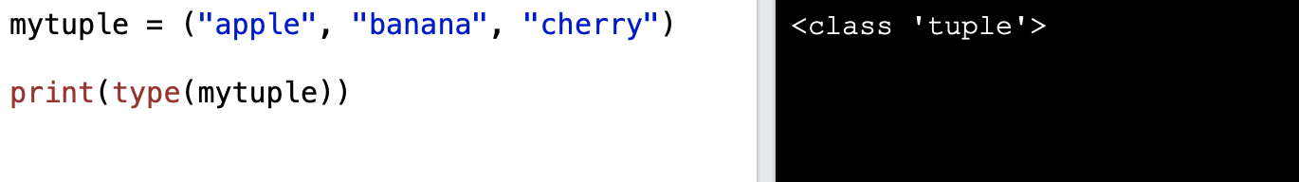
Data Types for Multiple Items(continued)
type()
Tuples are objects having the data type "tuple" according to Python:
the class "tuple"<class 'tuple'>

Slide 11
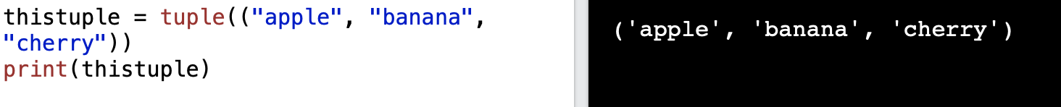
The tuple() Constructor
As an alternative, a tuple can be created using the tuple() constructer

Slide 12
Tuples
Tuples have a more constrained list; they cannot expand, contract, or have things added or removed, which makes them less useful but also allows them to operate more quickly due to their lower overhead.
Good if you're dealing with pairs of objects where you know there will always be two, or with visuals where, say, the colours red, green, and blue go together.
Usually used carelessly in situations like for index, value in enumerate(x): a tuple is present in there around the comma, therefore no () is necessary.

Slide 13
Tuples (continued)
When using fixed sets of items, you need to utilise tuples.
Tuples being used as keys for dictionary entries is one illustration (the key must not be changed).
Additionally, the use of tuples is crucial when the job requires integrity support, which means that the tuple cannot be altered by a different link.
Lists must be used in tasks where it is necessary to use collections of things that can be altered.

Slide 14
Why Data Analytics Using Python?
There are many programming languages available, but Python is popularly used by statisticians, engineers, and scientists to perform data analytics.
Here are some of the reasons why Data Analytics using Python has become popular:
Python is easy to learn and understand and has a simple syntax.
The programming language is scalable and flexible.
It has a vast collection of libraries for numerical computation and data manipulation.
Python provides libraries for graphics and data visualization to build plots.
It has broad community support to help solve many kinds of queries.

Slide 15
Python Data Analytics Libraries
Python offers a variety of libraries, which is one of the key reasons why it has become the most popular and preferred method of data processing.
NumPy: NumPy offers tools for numerical computing and supports n-dimensional arrays.
It is helpful for Fourier transform and linear algebra.
Pandas: Pandas offers tools for handling missing data, running calculations, and modifying the data.
The Matplotlib software is frequently used to plot data points and produce interactive data visualisations.
SciPy: Scientific computing is done using the SciPy package.
It includes modules for signal and image processing as well as modules for integration, interpolation, special functions, and linear algebra.
Scikit-Learn: The Scikit-Learn library includes tools that let you create models for classification, clustering, and regression.

Slide 16
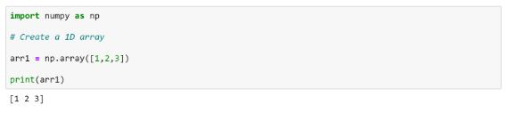
Make a NumPy array first.

Slide 17
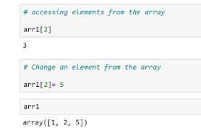
Use the array's elements to your advantage.

Slide 18
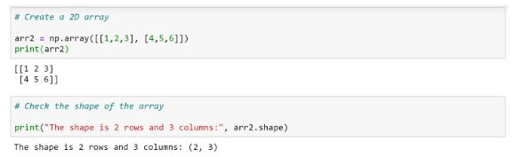
Make a 2D array, then examine its shape.

Slide 19
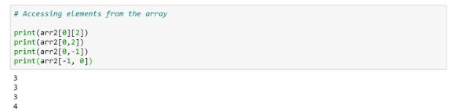
Utilizing the 2D array's index positions, access elements

Slide 20
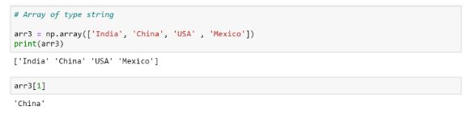
Make a string-type array.

Slide 21
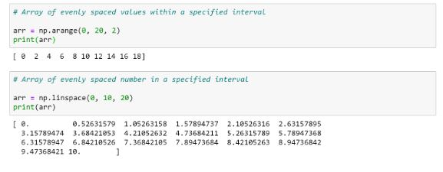
Distributing values uniformly within a certain period using the arange() and linspace() functions.

Slide 22
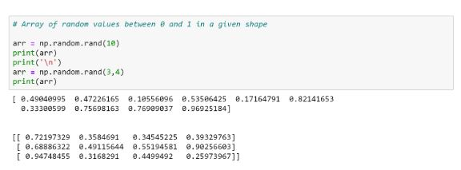
Create an array of arbitrary numbers in the range of 0 and 1.

Slide 23
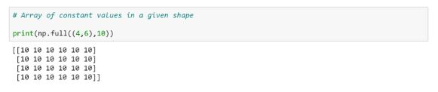
Make a shape-specific array of constant values.

Slide 24
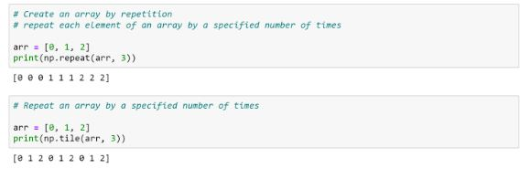
Using the repeat() and tile() functions, an array's elements can be repeated a certain number of times.

Slide 25
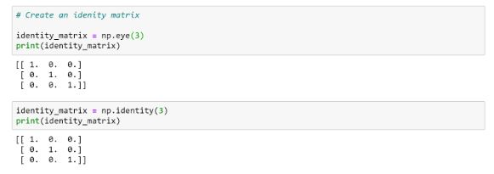
Using the eye() and identity() functions, construct an identity matrix.

Slide 26
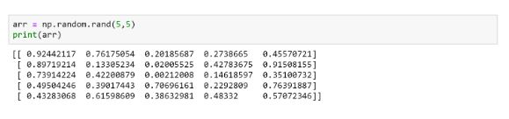
To generate random numbers between 0 and 1, create a 5x5 2D array.

Slide 27
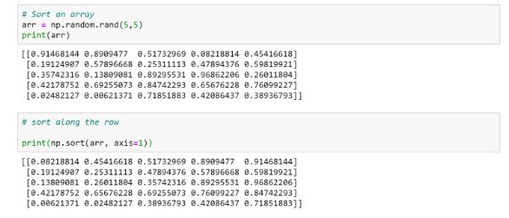
Sort an array along the row using the sort() function.

Slide 28
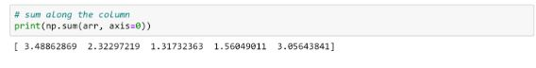
Summarize a column of an array.

Slide 29
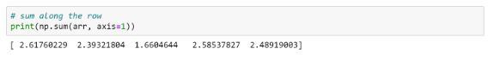
Over a row, add an array.

Slide 30
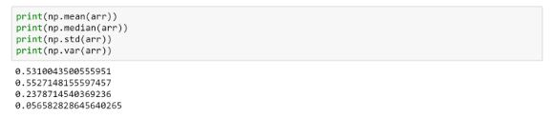
Determine the variance, standard deviation, mean, and median.

Slide 31
The sort() function can be used to arrange an array along a row.

Slide 32
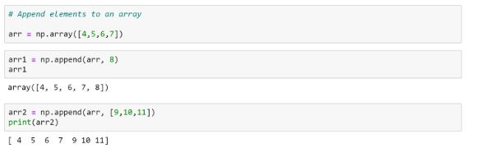
The append() function can be used to add elements to an array.

Slide 33
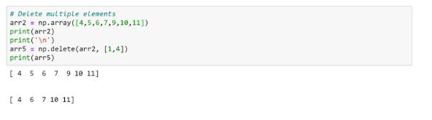
Remove several elements from an array

Slide 34
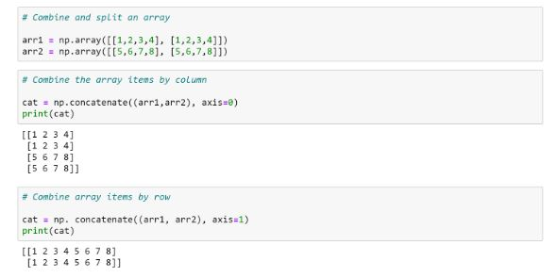
Combine the elements of two arrays.

Slide 35
Data analysis using Pythons library functions
To modify and visualise the data and uncover insights, you can a car.csv dataset and do exploratory data analysis using the Pandas, Numpy, Seaborn, and Matplotlib libraries.

Slide 36
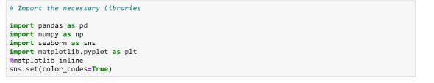
Bring the libraries in.

Slide 37
Use the pandas read csv() method to load the dataset.

Slide 38
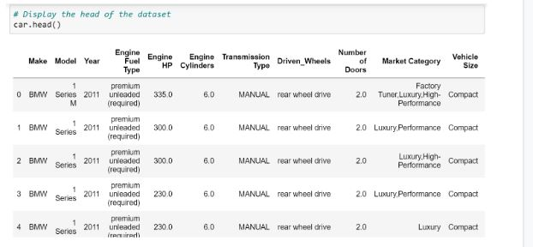
Use the head() function to display the dataset's head.

Slide 39
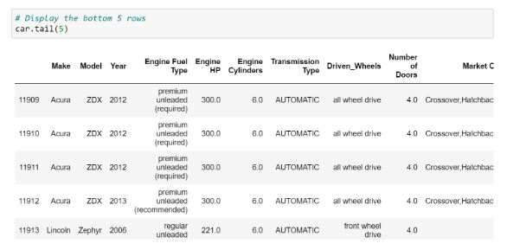
Use the tail() function to display the dataset's bottom five rows.

Slide 40
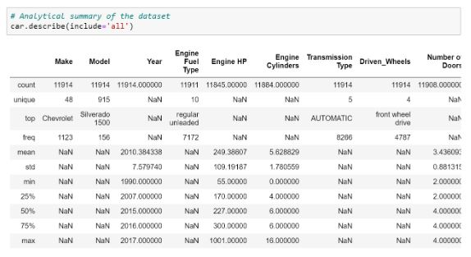
Using the describe() method, print the dataset's summary statistics.

Slide 41
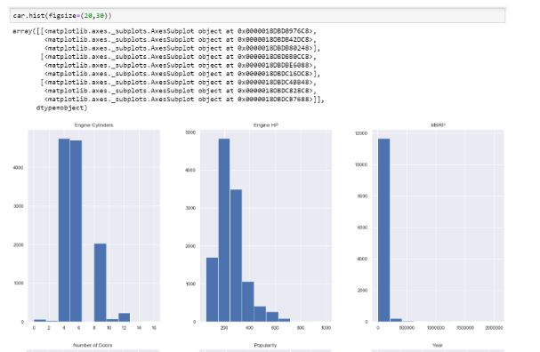
Plot a histogram with each variable included.

Slide 42
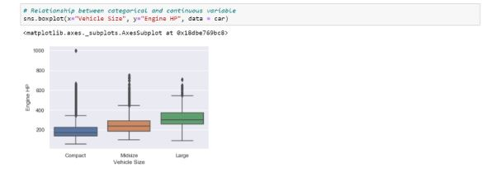
Box plot to show the connection between engine horsepower and vehicle size.

Slide 43
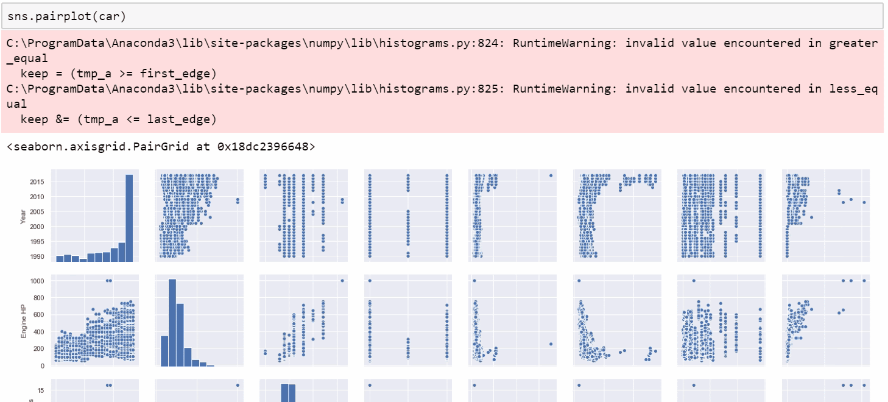
Utilize the seaborn library to create a pair storyline.

Slide 44
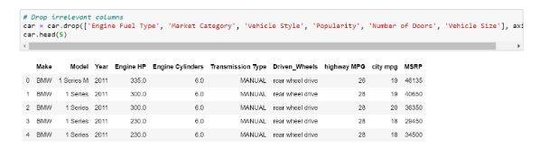
Using the drop() function, remove any unnecessary columns from the dataset.

Slide 45
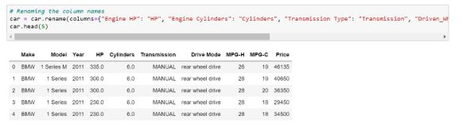
To rename the columns, use the rename() function.

Slide 46
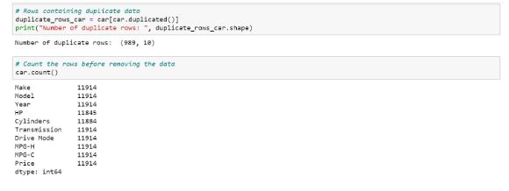
Print all instances of duplicate rows.

Slide 47
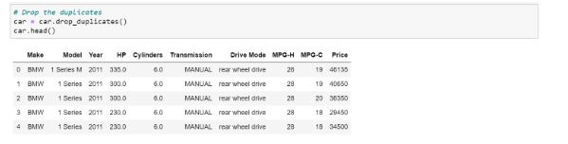
Use the drop duplicates() function to eliminate the duplicate rows.

Slide 48
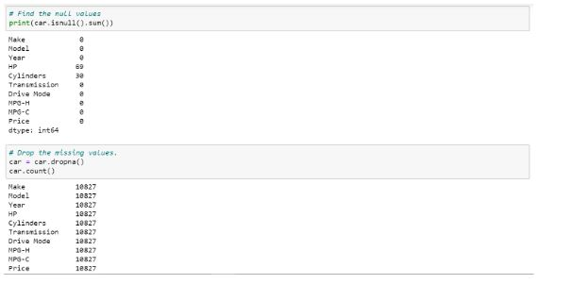
Remove the dataset's missing values.

Slide 49
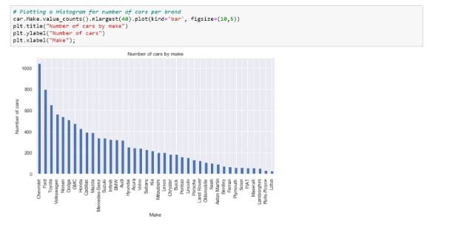
To determine the number of vehicles by brand, plot a histogram.

Slide 50
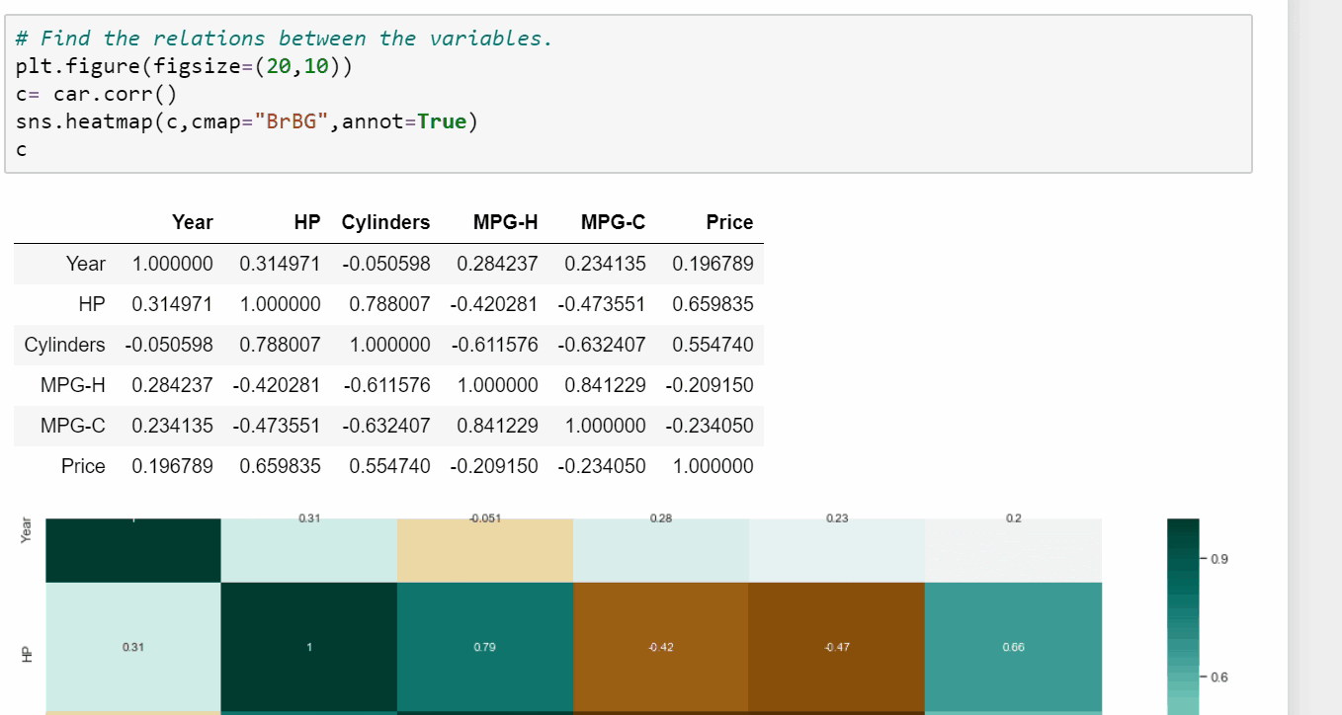
Plot the correlation between the various factors.

Slide 51
Use the drop duplicates() function to eliminate the duplicate rows.

Slide 52
Python for analysis
The preferred programming language of many data scientists and analysts is Python. It is a priceless addition to any data science and analytics toolset due to its relative simplicity, versatility, and large choice of third-party libraries. Libraries like Pandas, Numpy, Seaborn, and Scikit-Learn offer sophisticated capabilities to handle these and many other tasks, from data manipulation to visualisation and machine learning. Python's aptitude for data analytics and machine learning is substantially increased by these third-party libraries, but basic Python also has a number of built-in functions that are helpful to any data professional. I outline some of these functions , along with usage examples and sample code.

Slide 53
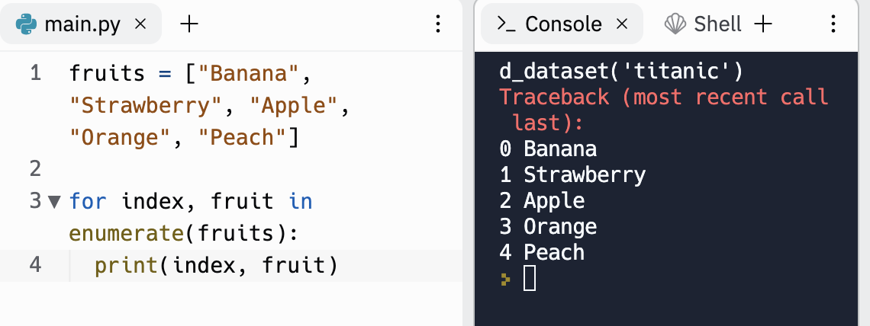
Enumerate
You can create a for loop with an index by using the enumerate() method. This implies that we can automatically give each item in an iterable a count variable. Enumerate() returns the value of the item at that iteration together with the count of the current iteration.
fruits = ["Banana", "Strawberry", "Apple", "Orange", "Peach"] for index, fruit in enumerate(fruits): print(index, fruit)
0 Banana 1 Strawberry 2 Apple 3 Orange 4 Peach

Slide 54
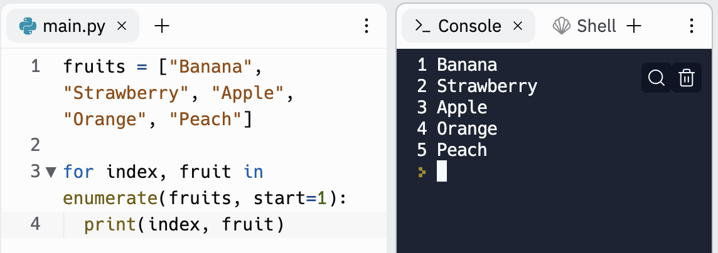
Changing index
As can be seen from the example above, Python takes care of everything automatically, so we don't need to worry about manually adding an index. The index begins at 0 by default, but we can change that by passing the'start' parameter.

Slide 55
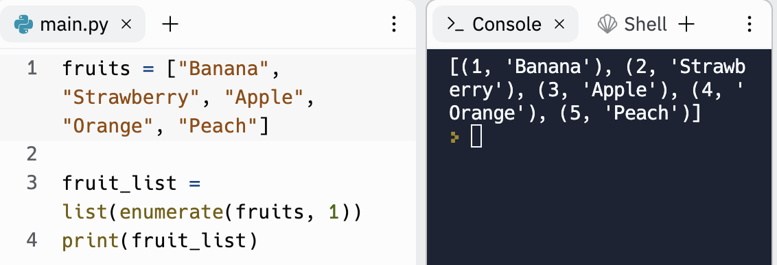
Changing index (continued)
By combining the list() method with the enumerate() function, we can additionally produce tuples that contain the index and list item. Here's an illustration:

Slide 56
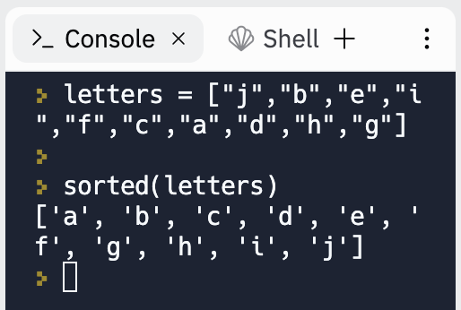
Sorted
The sorted() function accepts an iterable object as input and outputs a sorted list of every item in the iterable, as you might have guessed from the method's name. Numbers are sorted numerically, while strings are arranged alphabetically. The elements are arranged by default in descending order.

Slide 57
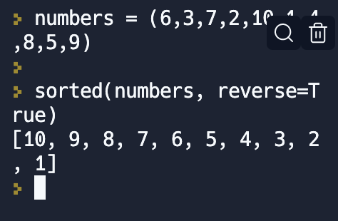
Sorted (continued)
However, we can specify the sort order by giving the "reverse" option a True (descending) or False (ascending) value.

Slide 58
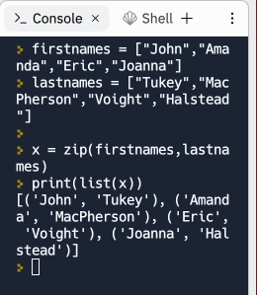
Zip
To group things from various iterators, use the zip() function. It gives back a zip object that contains tuples of the objects from each iterable.

Slide 59
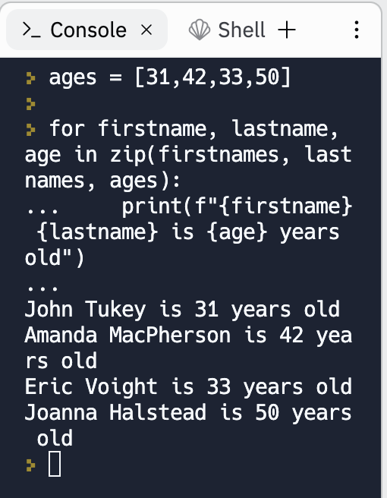
Zip(continued)
One thing to keep in mind is that zip() will ignore the items in the longer iterators if the given iterators have different lengths and end when the shortest one is finished.
The readability of for loops is increased by the zip() method. Instead of requiring several inputs, we merely utilise one zipped list in the example below. We're zipping three lists since I added a third item called "ages.”

Slide 60

Zip(continued)
To generate a dictionary object, this function can also be used in conjunction with the built-in dict() function.

Slide 61

Zip(continued)
Finally, by utilising the * operator, we can utilise the zip() method to unpack a collection of elements (tuples) in a list into separate tuples.

Slide 62

Map
An iterable object, such as a string or tuple, and another function are sent to the map() method, which returns the results after applying the supplied function to each item in the iterable.

Slide 63

Filter
The filter() method is similar to the map() function in that it accepts another function as well as an iterable, such as a list or tuple, and returns the elements of the iterable for which the other function returns True.

Slide 64

Isinstance
To determine whether an object is an instance of a particular class, use the isinstance() function. It requires two inputs—an object and the name of the class—and outputs either True or False depending on whether the object is an instance of the given class.

Slide 65

Range
A series of numbers with the requested length is returned by the range() method. Start, Stop, and Step are the three reasons that are accepted. The optional "start" argument, which sets the start of the series and is by default set to 0 A necessary number that specifies the sequence's end point is the "stop" argument. Last but not least, the optional'step' input sets the value of the increase from one integer to the next.

Slide 66

Round
When a floating-point number is entered, the round() method by default rounds it up to the nearest integer. The 'ndigits' option will round the input to the number of entered decimal places if it is supplied.

Slide 67

Set
One of Python's four built-in collection data types is called a set, which may hold numerous things in a single variable. Unchangeable, unordered set items do not permit duplicate values. The set() function outputs a set after accepting another collection object, like a list or tuple.

Slide 68

All and Any
These two functions are somewhat related and often complement each other. The all() function takes in an iterable such as a list or tuple and returns True if all the elements in the iterable are true, and False if one or more of the items are false. In the example below, we check if all the numbers in the list are even numbers using the all() function.

Slide 69

All and Any (continued)
When given an iterable as input, the any() function returns True if at least one element is true. If none of the elements in the list are true, it returns False. In the example that follows, we determine whether there are any even numbers among the list of numbers.

Slide 70

Eval
A user can execute Python code from a string-based or compiled-code-based input using the eval() function. When attempting to evaluate Python expressions that are presented in a string format, such as a mathematical equation, this function is extremely helpful.

Slide 71

Format
Based on a provided format, the format() method returns a formatted version of a value. It requires a value to format as well as a description of how the value should be presented as two arguments.

Slide 72

Setting up Matplotlib and producing a simple line plot ​
The following Python code should be added to a new Python repl.

Slide 73

Creating a state-by-state scatter plot of US cities
In order to depict 2D data, find correlations and other patterns, scatter plots are frequently utilised. They can, however, also be used sloppily to plot geographical X-Y coordinates (in reality, the field of plotting geographical points is far more complicated). For our next visualisation, we'll create a subset of the city data from simplemaps. The data set's rows each represent a different American city, and each row includes the city's latitude, longitude, and two-letter state code.
Replace the code in your main.py file with the following to download and visualise the data.

Slide 74
Conclusion
Data in many different formats is being produced quickly. And businesses are using data analytics to uncover hidden insights and useful information in this data. You would have understood what data analytics is and the numerous uses of data analytics after reading this article on "Data analytics using Python." Additionally, you examined several forms of data analytics and procedural methods. Finally, you applied Python's NumPy, Pandas, and Matplotlib packages to data analytics.

Slide 75
What can I do with R analytics?
R can already be used in a wide range of sectors and industries in several ways.
Building unique data collecting, grouping, and analytical models is a typical application of R for business analytics.
R data analysis enables businesses to build custom statistics engines that can deliver better, more pertinent insights because of more accurate data collection and storage.
More crucially, adopting R rather than boxed software enables businesses to quickly reuse previous queries and perform ad hoc studies while building in techniques to check for faults in analytical models.
R and Python should be included in your analytics stack in order to get the most out of your data.
They can be integrated to the point that using them is as simple as using SQL.
R is a crucial tool for academics and other fields that place a greater emphasis on research, as these areas of study typically need for very particular and distinctive modelling.
As a result, businesses may quickly create analytical tools on a custom basis that integrate with current statistical analyses while producing insights that are considerably deeper and more precise.
R can typically offer models that deliver better or more precise insights than common metrics like page views or bounce rates, even when it comes to social media or web data.

Slide 76
Setting up R&R Studio
You can download the R setup file, and once that is done, you will need an IDE like RStudio to begin programming.
You are now ready to start using R for programming after downloading and installing the aforementioned applications.
You can now launch R Studio, select File, New File, and then R Script.
Let's start using R for data analysis.

Slide 77
Importing Libraries and Installing Packages
Making an automobile doesn't require inventing the wheel every time.
The same is true with programming.
A library is a group of functions created to carry out specific tasks.
As a result, each time a programmer writes a piece of code, rather than writing tens or even hundreds of lines to carry out a single, straightforward action, like determining the square root, he or she just uses a function that is built into the basic R library.
Libraries are gathered in packages.
I'll be mostly concentrating on the data wrangling and data visualisation aspects of data analytics since the goal of this article is just to become comfortable with the fundamentals of the R language.
In the articles that come after this one, I'll talk about modelling and other important ideas.
The following libraries will be used for data wrangling:
The preferred package for data manipulation is dplyr.
used to manipulate data sets' rows and columns and even to combine different data sets.
tidyr: Exactly as its name implies, this programme is used to clean up data.
Dates and times can be changed and manipulated with lubridates.
For handling categorical variables, use forcats.
In the updates, we'll talk more about this.

Slide 78

R Libaries
ggplot2 pretty much contains everything you may need for data visualisation.
Although there are many valuable libraries, you shouldn't worry too much about remembering every one of their names in order to utilise them efficiently.
R offer packages like "tidyverse" for this purpose.
The libraries mentioned above as well as many more are included in this bundle.
Therefore, let's install this package in R and import it into our application using the instructions below:

Slide 79

Using Internal R Datasets
Run the following line of code in the console to get a list of all the sample datasets that R comes preloaded with, along with their names and brief descriptions: data()

Slide 80

Data Wrangling and Analysis in RStudio
We may access, manipulate, transform, analyse, and model the data in R in RStudio just like in any other R IDE. The standard operations carried out on the CO2 built-in dataset are demonstrated here.

Slide 81

Data Plotting in RStudio
We may plot the data in RStudio just as in any other R IDE.
Here are a few illustrations of straightforward plots made using the CO2 and Orange built-in datasets.
The resulting plot is displayed on the Plots tab in both situations and may be exported using that tab's Export button:
How to make a histogram : hist(CO2$uptake)

Slide 82

How to make a scatter plot
How to make a scatter plot:
plot(Orange$age, Orange$circumference)

Slide 83

Aesthetic appeal
To give the previous plot some aesthetic appeal, we may adjust a few of the basic plot() function's available parameters:
plot(Orange$age, Orange$circumference, xlab="Age", ylab="Circumference", main="Circumference vs. Age", col="blue", pch=16)

Slide 84

R Data Creation from Scratch
Again, in this instance, RStudio is identical to every other R IDE. Creating a vector

Slide 85

Making a dataframe entails
oceans_depth <- data.frame(oceans, avg_depth)

Slide 86

Printing the outcome
print(oceans_depth)

Slide 87
Bringing in the Data set
We will use a data collection of the 1000 most popular films according to IMDB reviews for analysis.
The data was created by promptcloud using information gathered from "Kaggle."
Since the data set was last updated in June 2017, it is impossible to determine how accurate it is in the current situation.
However, since we are only using this data set for demonstrations, it will be perfect for our needs.
We are now prepared to import the data into our R script after getting the data set from the aforementioned link and putting it in the directory of our choice.

Slide 88

Bringing in the Data set (continued)
You can immediately call out the file name if you have saved your file in the working directory.
However, you must first make the location where you saved the file a working directory.
Following that, you can call out the file name directly.

Slide 89

Bringing in the Data set (continued)
The file is saved under the name "IMDB moviedata.csv" in my instance.
Comma-separated values, or CSV, stands for.
Each piece of data is separated in this style by a comma.
However, other characters can also be used to divide the data into its component parts.
You can use the following command to access the R manual for further information:

Slide 90

Organising the data
Now that our data set has been imported, we usually cannot use it right away since it may not be properly sorted or it may contain properties that are not necessary for our study. Let's first have a look at our data before we do that. Any or all of the commands mentioned below may be used to do this.

Slide 91

Organising the data (continued)
Here is a sample of the glimpse function's output.

Slide 92

Organising the data (continued)
So let's start organising the data.

Slide 93

Data Analysis and Visualization
We will conduct some elementary analysis of the imported data set in this part.
Let's first contrast the box office success of the top 10 movies.
The movies are already organised according to their ranks in our data collection.
Starting with the top 10 films in the data frame, we will compare their box office takings.

Slide 94


Data Analysis and Visualization (continued)
The data frame that will be used for this analysis is shown below.
Be aware that Rank 8 is absent.
This is because during the data cleaning procedure, rows with missing values were eliminated.

Slide 95

Data Analysis and Visualization (continued)
Bar graphs and labels are combined in the graph below.
Bar graphs and ranks are displayed using geom_col and geom_label, respectively.

Slide 96


Data Analysis and Visualization (continued)
Compare who has made the most money as a director now.
Using the aggregate function, we will total up each director's earnings for this analysis. We will also compare how many films each of them has directed.

Slide 97


Data Analysis and Visualization (continued)
Let's now examine the performance of the Top 1000 films by creating a histogram that displays the correlation between the amount of money made and the frequency of each earning range.

Slide 98

Conclusion
Regarding the application of Python and R, there are differing opinions.
There are benefits and drawbacks to both of these languages.
R is also in use, however Python is utilised by many people for many individuals.
R is mostly used for statistics, while Python is utilised for a wide range of features.
The user must choose the language based on the situation.
The preferred programming languages for data analysis, data science, machine learning, etc. are Python and R.
Even though they are both employed for similar goals, they are different from one another.
R primarily concentrates on the statistical aspects of programmes, but Python is more flexible in terms of usage and data analysis goals.
R is an effective tool for visualising data as graphs.
Given that Python is just integrated with a compound work environment, it is challenging to use R in a production domain because its production tools are still under development.
Python is a better alternative when it comes to performance because it performs better than R in all environments.
Nevertheless, depending on their usage, both programming languages are favourites among users.

